Slide 1



Slide 2
Team RoboSmile
SafeCircles
Notes:
Welcome to our Kick-Off event for the MEXA community! We have a really exciting event planned for you today.

Slide 3
Team RoboSmile
Safe Circles: LMM-facilitated personalised online support groups
Team members and roles:
Adam Loyd Harris. Software lead, Conceptualisation, Writing, LE (github.com/AdamLoydHarris, x.com/AdamLoydHarris)
Limou Dembele. Investigation, Writing
Luis Torrao. Software review (https://www.researchgate.net/profile/Luis-Torrao )
Clàudia Llinares.
María Navas-Loro. Ideation

Slide 4

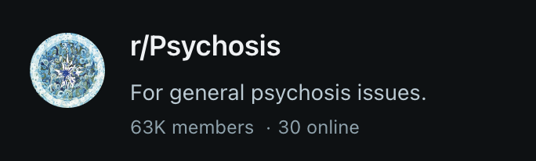
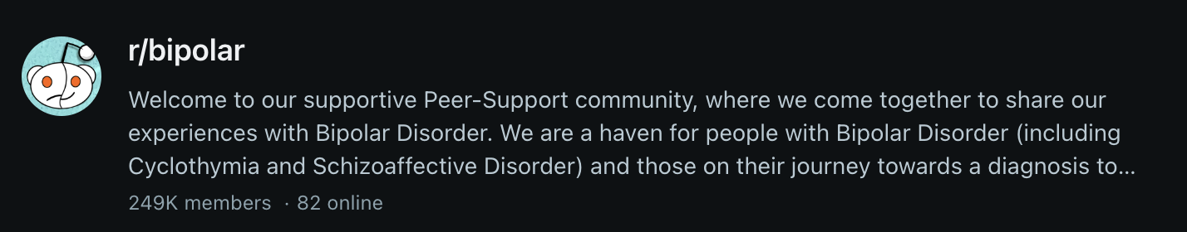

Online support communities for mental health form spontaneously.

Slide 5
Online Support Forums
People sharing experiences with medications, outlook, just venting
Have huge membership:
Great for breadth of experiences shared
Can make people uncomfortable posting to such a vast audience
Unstructured and unguided conversations can lead to ‘blackpilling’ or toxic conversations, where negative thought and feelings are reinforced

Slide 6
Social solutions are not a priority for health services

Slide 7

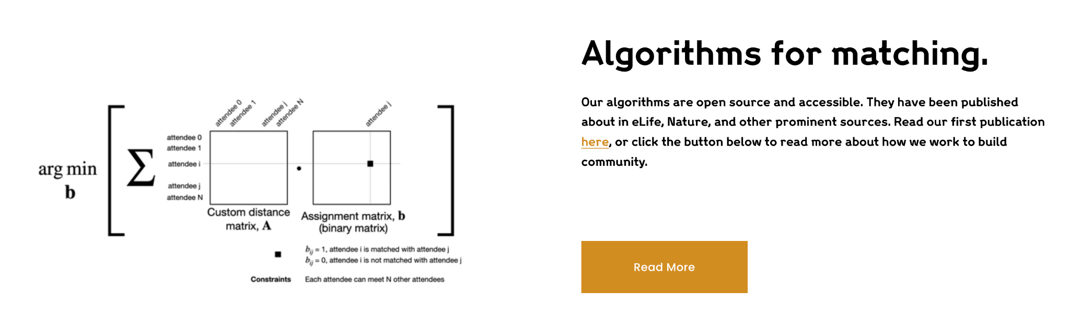
SafeCircles: Small group messaging with conversations facilitated by language model
Use natural language processing to group people with similar problems, and mix people who are managing well with those not managing so well.
Language model, modelled on Lived Experience experts, suggest topics, post polls, and build models of the group members.
Keep people engaged and conversations moving in healthy directions.

Slide 8
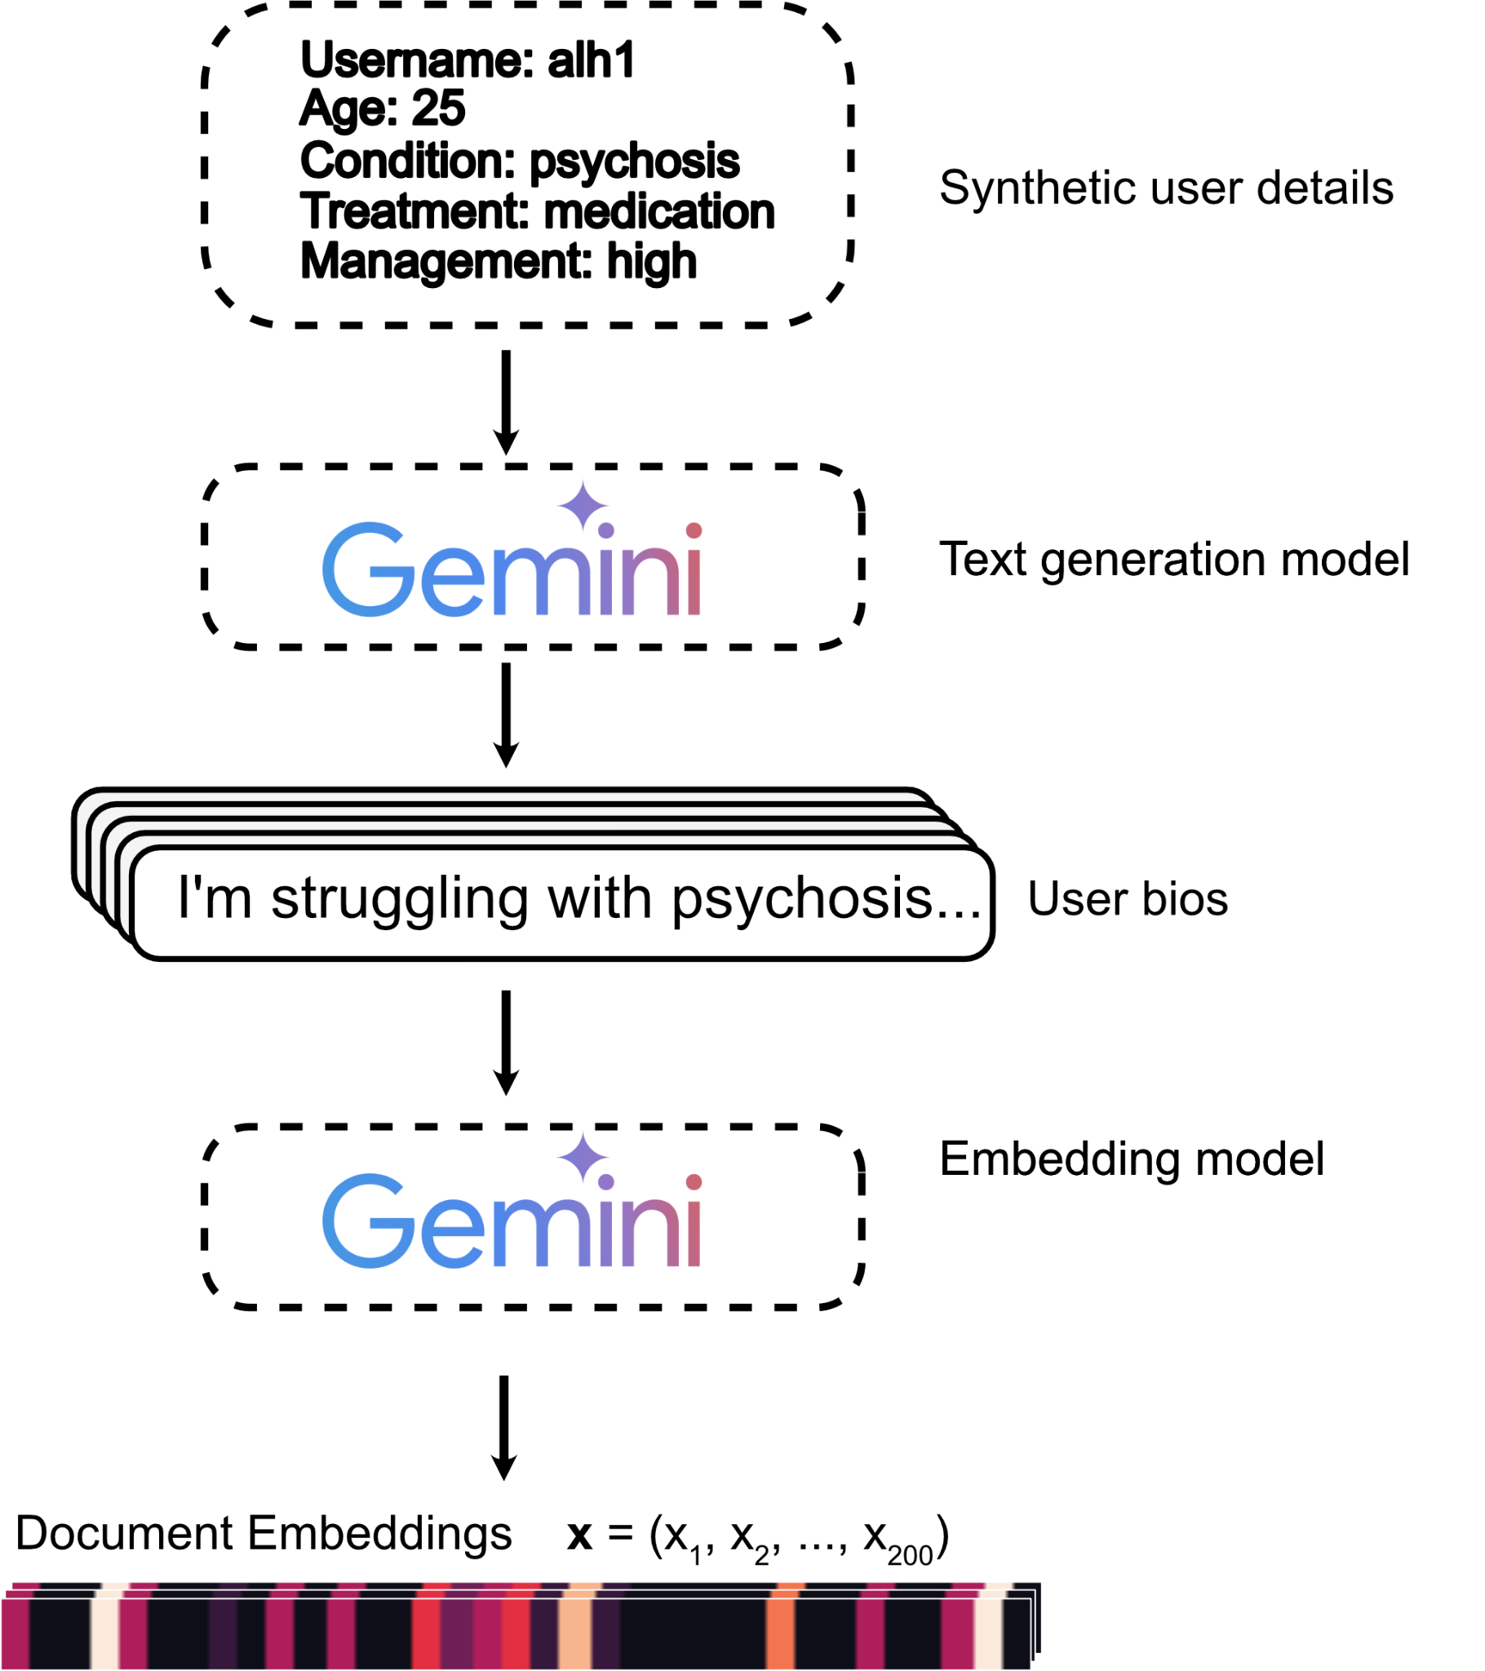
Technical Approach: Making dataset
300 synthetic users with depression, anxiety or psychosis, with varied demographic information and treatment strategies
Used Gemini-1.5-flash to write bios
Gemini text-embedding-004 to make vector representation

Slide 9
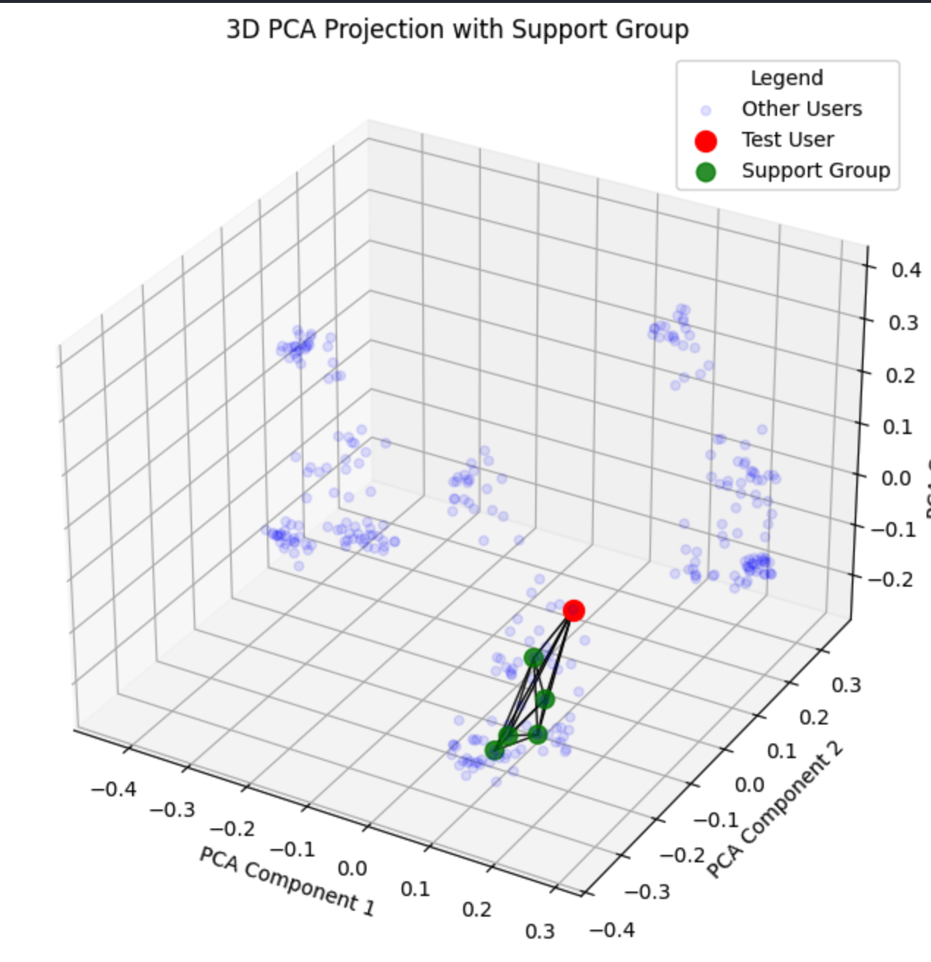
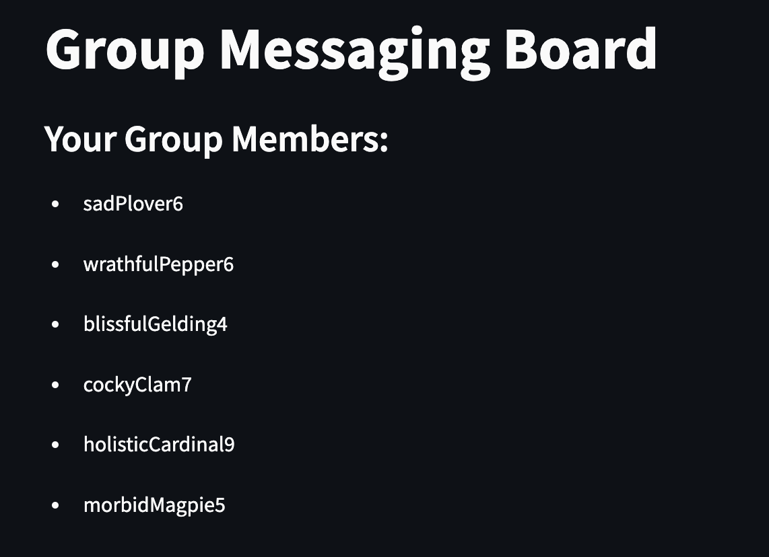
Matching users with text embeddings
Find and group users close to each other in embedding space using simple cosine similarity measure in sk-learn. Here displayed in 3 dimensions by PCA.

Slide 10
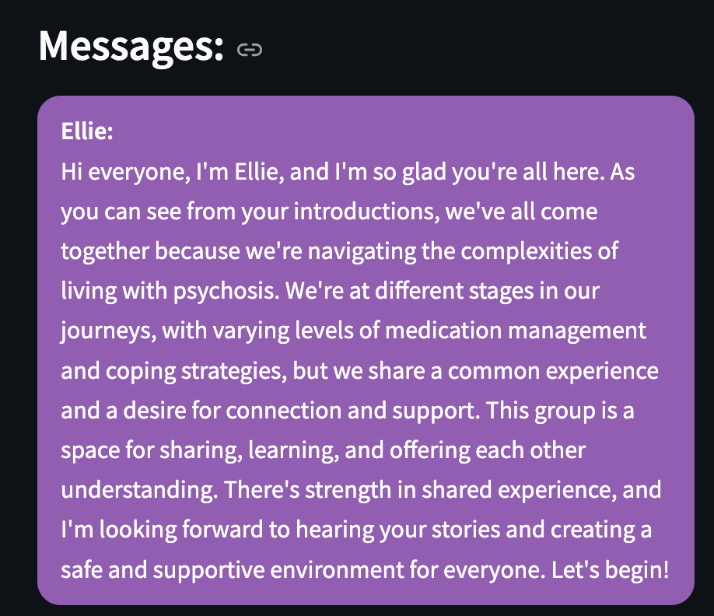
ELLIE listens to conversation
To start, ELLIE is given each user’s bio and provides a brief introduction. It is prompted to be a personable, informal, and inclusive mediator.

Slide 11
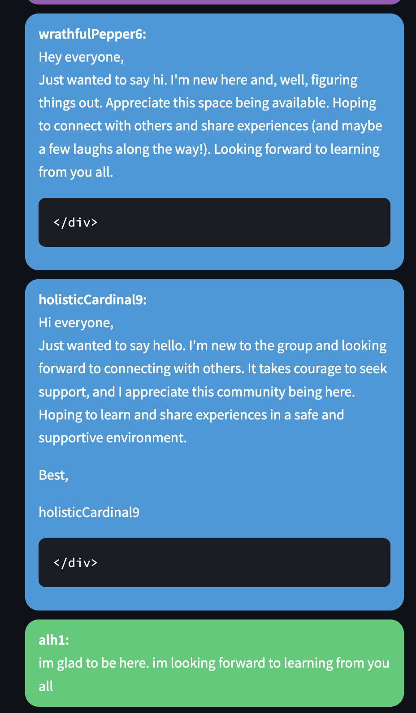
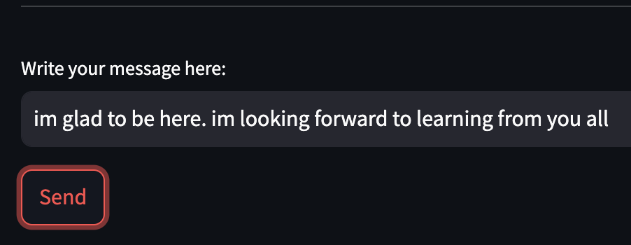
Conversation between users
Here, text users in blue are agents based on their bio in the database These would be real people also using the service.

Slide 12
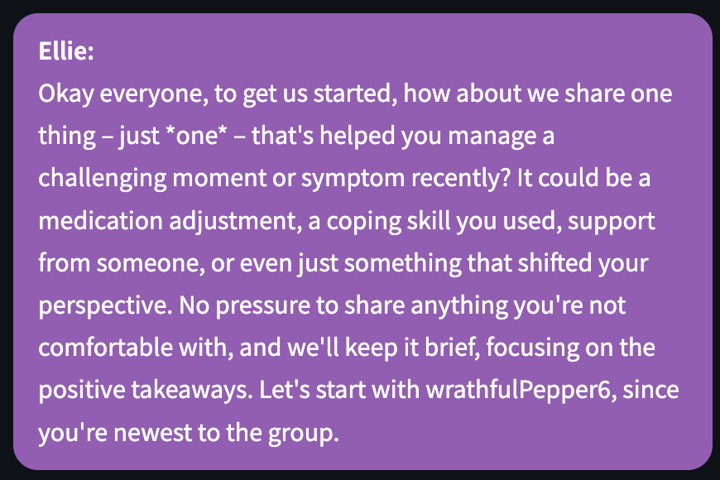
ELLIE has access to chat history and provides its own posts
Can address specific users to counterbalance imbalances in how often people contribute

Slide 13
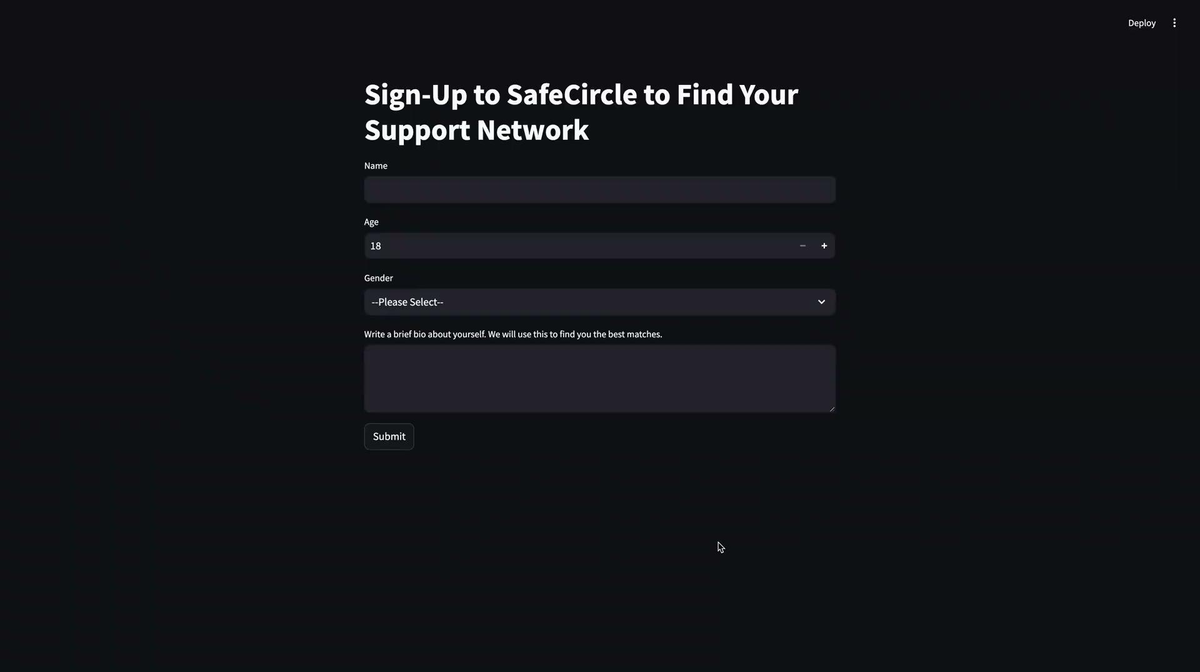
Demo: Streamlit app.

Slide 14
Plans to Embed Lived Experience
Co-designed with people with lived experience of anxiety, depression and psychosis to identify barriers and opportunities for engagement
LE experts and practitioners design prompts to get optimal behaviour.
Considering intersectionality community experiences of social dynamics of race, gender, class, sexuality and how they shape response to mental health issues
LE experts will also be able to join a monitoring committee and engage in periodic auditing process (ex: cyber guardians)

Slide 15
Impact and Relevance
The LLM is only there to mediate community cohesion. People are still ultimately helping each other.
Breaking barriers regarding AI mental health support as they’re mostly talking with real people
Added value of supporting mental health in the community - peer support - filling a gap left by traditional treatment avenues of talking therapy and medication
Addressing the risks inherent to social discrimination and stigmatisation
Encourage resilience and help seeking behaviours (Agency) even in times when the traditional mental health structures are saturated
Embedding lived experience expertise all the way to enhance care, inclusion, and community cohesion around mental health

Slide 16
Risks and Ethics
Error bias - hence the engagement plan with lived experience experts
Maintaining empathy
Bridge of privacy or misuse of content compromising personal and mental health integrity
Failing safeguarding processes - missing or misinterpreted signs of potential harm to self, to others
In some places access will be disrupted (connectivity, electricity…) - how to make sure users and supporters do not lose at crucial moments (when the need is stronger?)

Slide 17
Risk mitigation
LLM performing content review for harmful topics like suicide and self harm. Can be further reviewed by human experts. Also helpful to keep generating content that inspires empathetic behaviours/engagements, build trust, consider emotions and ethics
Referral mechanism/safeguarding to prevent service being abused to access potentially vulnerable people
Maintaining anonymity using avatars
Code of conduct /awareness raising and user friendly guidance on how to interact and protect oneself from sharing data that can give away their identity

Slide 18
Uptake and Scalability
Online support networks are clearly an appealing resource for people seeking help (see Reddit examples)
LLMs are costly to deploy at scale, although this is likely to get cheaper (see new DeepSeek R1 model as an example)
Neuromatch have already solved efficient matching for worldwide collaboration
Could integrate with existing social apps to use their infrastructure rather than reinventing social networking from scratch

Slide 19
Future Work
Integrate into existing social platforms, like Meta’s Groups app
LLM adapts its communication style based on how the group speak to each other
Have multiple agents in a conversation with different personalities and roles
Use LE experts to design types of interjection, identify types of toxic interaction

Slide 22
Support group notes - background
Online supportive communities for mental health issues have formed online on platforms like Reddit. These see people discussing things like management strategies, experiences with medication, outlook.
However, the openness and high number of users of these forums can prevent people sharing their issues if they don’t want it to be seen by so many people. (I know this because I occasionally visit these forums, and never want to post!)
Also risk of ‘blackpilling’ - where negative experiences and emotions are reinforced.

Slide 23
Support group notes: proposal
Small, anonymous, online support groups that bring together people going through similar struggles.
Users provide bios (self input); demographic information; language spoken; how well they are managing their particular mental health problems
A neuromatch style algorithm puts the user into a small group of say ~10 people with balance of levels experience with their issues and how well they deem themselves to be managing
A LLM can mediate and guide conversation based on previous conversation history. Ideally, it will be fine tuned on a dataset of real human support group sessions.

Slide 24
Plans to Embed Lived Experience
Co-designed with people with lived experience of anxiety, depression and psychosis to identify barriers and opportunities for engagement, maximizing a human centred design process and leverage their expert views from idea to prototyping and testing. Their review will strengthen the benchmarking of the LLM
Iterative review in place
Their engagement and expertise will be instrumental for the LLM design to be set up for success and navigate the complexity of human identity, experiences of social dynamics and the interconnectedness of race, gender, class, sexuality and how they shape response to mental health issues
Intersectionality is a lens that should be considered for community support, the dynamics are not stable personality traits
Their inputs will help LLM to be adaptive and agile
Lived experience experts will also be able to join a monitoring committee and good engage in periodic auditing process (ex: cyber guardians)

Slide 25
Support group notes: potential problems
Need strong moderation and safeguards for high-risk situations like mentions of self harm or suicide
Differences in the population (particularly across countries and cultures) in recognising and discussing mental health.
Maintaining anonymity to highest extent practicable. Serviced could be abused to access vulnerable people?
This is a great opportunity to explore how Lived Experience and intersectionality could be embedded into LLM design
Find how LLM could be an alternative to overcome mental toll of human online mental health safeguardians

Slide 26
User Experience and Interface
The service would work like a social media group chat, with one or more of the members being a mediator LLM
LE experts and clinical practitioners design LLM prompts to get optimal behaviour. Could even model distinct personalities based on real people.
Automated content moderation will flag problematic topics to human mental health practitioners

